Slide 1


MO HealthNet PharmaCy Program and Budget Update
MHD DRUG PA COMMITTEE December 15, 2022
Elizabeth Short, Program specialist

Slide 5

MEDICAID EXPANSION
October 2022
PARTICIPANTS 274,164
EXPENDITURES $29,144,375
CLAIM COUNT 243,258

Slide 6

TOP 4 DRUG CLASSES PER FY
 | FY2021 Expenditures | FY2021 Claim Count
Paliperidone Palmitate(Invega) | $50,783,647 | 19,191
Adalimumab(Humira) | $47,631,914 | 6,928
Lurasidone HCL(Latuda) | $40,962,690 | 34,399
Methylphenidate HCL(ADHD) | $32,590,476 | 121,636
 | FY2022 Expenditures | FY2022 Claim Count
Adalimumab(Humira) | $65,085,308 | 8,983
Paliperidone Palmitate(Invega) | $55,188,350 | 20,453
Lurasidone HCL(Latuda) | $43,154,241 | 35,334
Methylphenidate HCL(ADHD) | $35,358,173 | 130,708
 | FYTD2023 Expenditures | FYTD2023 Claim Count
Adalimumab(Humira) | $38,191,407 | 4,959
Paliperidone Palmitate(Invega) | $26,948,969 | 9,741
Biktarvy(HIV) | $23,628,453 | 7,427
Lurasidone HCL(Latuda) | $20,402,908 | 16,486

Slide 10
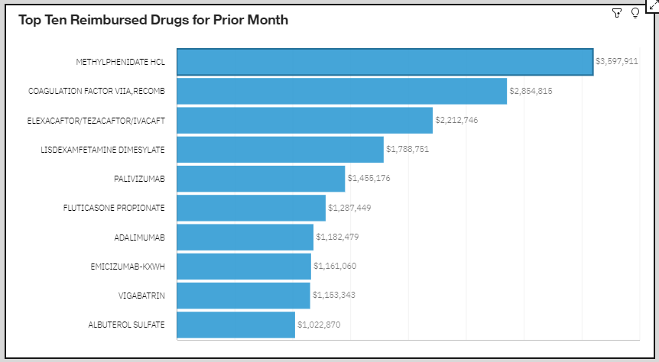
NOV 2022 TOP TEN REIMBURSED DRUGS FOR CHILDREN 0-17

